Slide 1
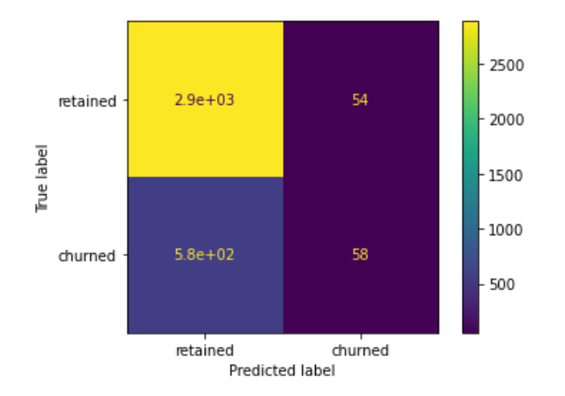
User Churn Project: Regression Model Results
Executive Summary prepared for Waze leadership team
Waze leadership ask data team to develop a churn predictive model that will help prevent churn. improve user retention, and grow Waze’s business. This report is made by Waze data team after performing a binomial logistic regression model. Binomial logistic regression model offer felixibility and predictive power that can be used by management to make a larger business decision.
Target:
Build and analyze a binomial logistic regression model.
Methods:
Create features of interest to the stakeholders and business scenario
Asses for multicollinearity
Build the regression model
Evaluate the model’s performance
Impact:
Binomial logistic regression model can reveal important variable relationships and predict binary outcomes, that can help management.
The performance of a binomial logistic regression model is determined by accuracy, precision, and recall scores. Since we want to know more about churned users, recall score is particularly more important.
This model has 52% precision score (52% of its positive predictions are correct), and 9% recall score (only 9% churned users are identified), which means this model can not be used for significant business decision.
Activity_days was the most important feature in this model by far, and also it has a negative correlation with user churn.
Due to the model’s result, we recommend to further exploration.
This model should not be used to make significant business decision, however the valuable insight from this model can be used better define the user profile that Waze seeks to target, which in turn help Waze to decrease churn rate and improve customer growth.

